Slide 1
Location
Advanced Android Development
Lesson 7

Slide 2

7.1 Location services
Using physical location in an app

Slide 3
Contents
Overview
Setting up Google Play services
Location permissions
Get device location
Geocoding and reverse geocoding
Creating a LocationRequest object
Working with user settings
Requesting location updates

Slide 4
Overview

Slide 5
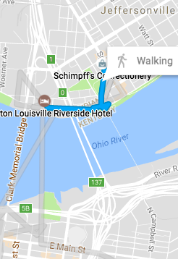
Introduction
Mobile phones – key word is MOBILE
Users move around and go places
Your app can detect and use the device location to customize the experience for the user

Slide 6
Using location in your app
Check if location permission has been granted
Ask for permission if necessary
Request most recent location
Request location updates
Notes:
High level; we look at each of these steps in detail

Slide 7
Get the device location
Use FusedLocationProviderClient
Makes location requests combining GPS, Wi-Fi, and cell network
Balances fast, accurate results with minimal battery drain
Returns Location object with latitude and longitude

Slide 8

Get the device location
Use Geocoder to convert lat/long location to physical address
Latitude 51.5
Longitude -0.078
Tower Bridge, Tower Bridge Rd, London SE1 2UP
UK

Slide 9
Setting up Google Play services

Slide 10
Setting up Google Play services
Location services are provided by Google Play Services
Install Google Repository in Android Studio
Select Tools > Android > SDK Manager
Select the SDK Tools tab
Expand Support Repository
Select Google Repository and click OK

Slide 11
Adding Google Play to your project
Add to dependencies in build.gradle (Module: app):
compile 'com.google.android.gms:play-services:xx.x.x'
xx.x.x is version number, such as 11.0.2.
Replace with new version number, if Android Studio suggests it

Slide 12
Location permissions

Slide 13
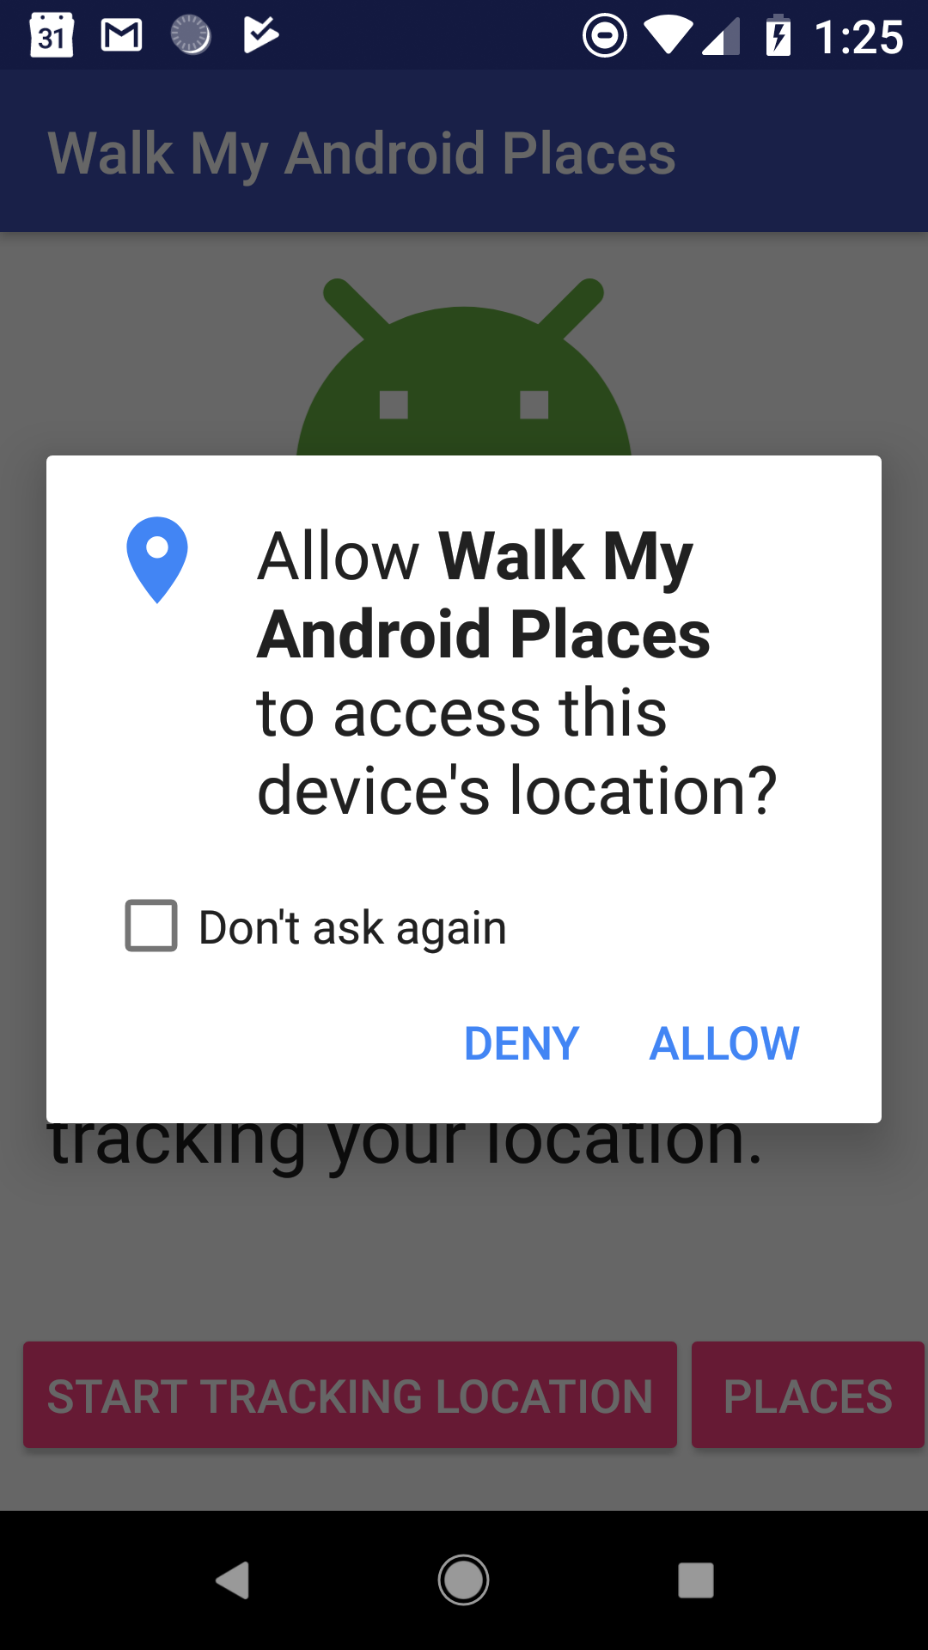
Users choose to share their location
From Marshmallow onwards:
Users grant or deny access to their location for each app
Users can change access permission at any time
Your app can prompt user to grant permission to use location

Slide 14
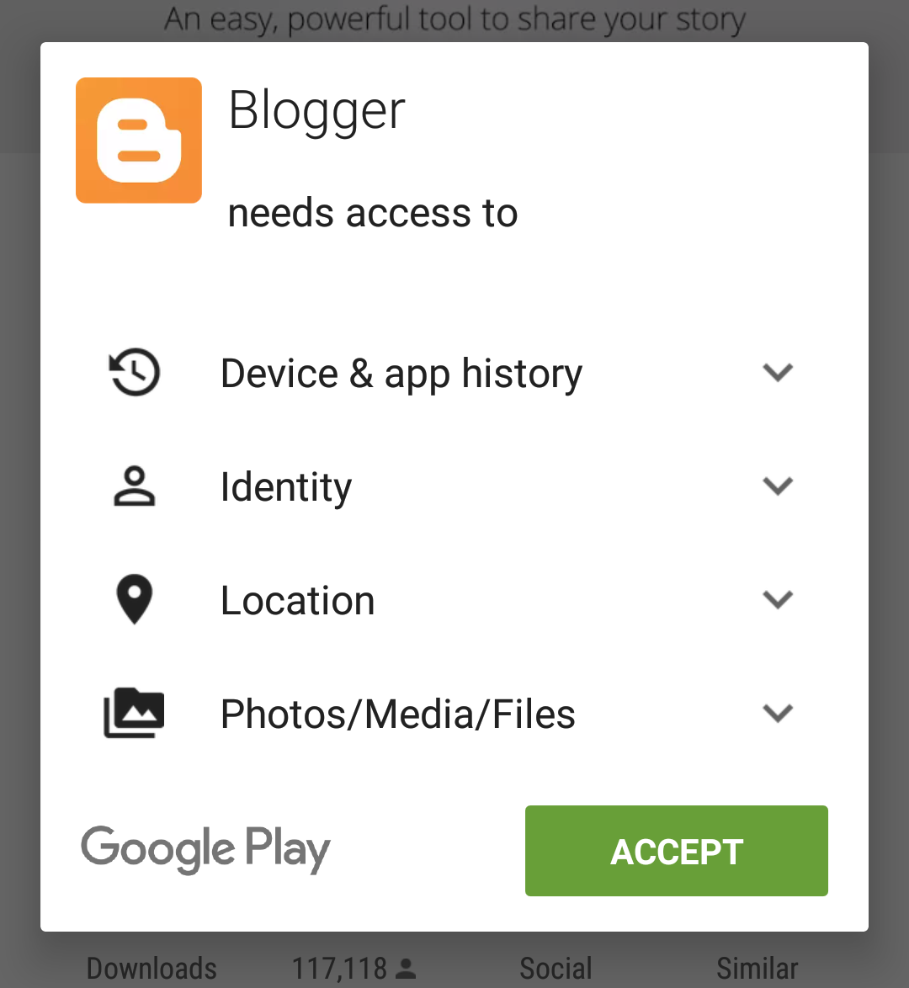
Users choose to share their location
For apps created before Marshmallow:
users grant permission before installing
after installation, user cannot change access permission
your app can check if permission has been granted

Slide 15
Requesting location permission
Apps must request location permission
ACCESS_COARSE_LOCATION for location accurate to within a city block
ACCESS_FINE_LOCATION for get precise location

Slide 16
Request permission in manifest
<uses-permission
android:name=
"android.permission.ACCESS_FINE_LOCATION"
/>

Slide 17
Requesting permission at run time
User can revoke permission at any time
Check for permission each time your app uses location
Details and examples: Requesting Permissions at Runtime

Slide 18
Steps to check/request permission
Use checkSelfPermission() to see if permission granted
Use requestPermissions() to request permission
Check user response to see if request was granted

Slide 19
Check/request permission
if (ActivityCompat.checkSelfPermission(this,
Manifest.permission.ACCESS_FINE_LOCATION) !=
PackageManager.PERMISSION_GRANTED) {
ActivityCompat.requestPermissions(this,
new String[]{Manifest.permission.ACCESS_FINE_LOCATION},
REQUEST_LOCATION_PERMISSION);
} else {
Log.d(TAG, "getLocation: permissions granted");
}

Slide 20
Get user's response
Override onRequestPermissionsResult() to check if user granted permission
@Override
public void onRequestPermissionsResult(int requestCode,
String permissions[], int[] grantResults) {
switch (requestCode) {
case REQUEST_LOCATION_PERMISSION: {
// Check if the permission is granted.

Slide 21
Check if request was granted
Response is returned in permissions array
Compare grantResults parameter to PackageManager.PERMISSION_GRANTED
// Check if the permission is granted.
if (grantResults.length > 0) && grantResults[0] ==
PackageManager.PERMISSION_GRANTED) {
// Permission was granted.
...
} else {// Permission was denied...

Slide 22
Get device location

Slide 23


FusedLocationProviderClient
Use FusedLocationProviderClient to request last known location
Usually, last known location is same as current location

Slide 24
Get FusedLocationProviderClient
To get FusedLocationProviderClient:
FusedLocationProviderClient flpClient = LocationServices.getFusedLocationProviderClient( context);

Slide 25
Requesting last known location
Call FusedLocationProviderClient getLastLocation()
Returns Task object representing async task to fetch Location object
Task supplies methods for adding success and failure listeners
Retrieve latitude and longitude from Location object

Slide 26
getLastLocation() success listener
mFusedLocationClient.getLastLocation().addOnSuccessListener(
new OnSuccessListener<Location>() {
@Override
public void onSuccess(Location location) {
if (location != null) {
mLastLocation = location;
// Get the lat and long.
} else { // Show "no location" }
}
});

Slide 27
getLastLocation() failure listener
mFusedLocationClient.getLastLocation().addOnFailureListener(
new OnFailureListener() {
@Override
public void onFailure(@NonNull Exception e) {
Log.e(TAG, "onFailure: ", e.printStackTrace());
}
}
);

Slide 28
Get latitude and longitude
public void onSuccess(Location location) {
if (location != null) {
// Get the lat and long.
lat = location.getLatitude(),
long = location.getLongitude(),
time = location.getTime()));
} else { // no location}

Slide 29
Geocoding and reverse geocoding

Slide 30
Geocoding and reverse geocoding
Geocode: Convert human-readable street address into latitude/longitude
Reverse geocode: Convert lat/long into human-readable street address
Latitude 51.5
Longitude -0.078
Tower Bridge, Tower Bridge Rd, London SE1 2UP
UK

Slide 31
Use the Geocoder class
Use Geocoder for geocoding and reverse geocoding
Geocoder geocoder = new Geocoder(context,
Locale.getDefault());
Methods make network request—don't call on main thread

Slide 32
Geocoder backend service
Geocoder requires backend service that are not included in core Android framework
Use isPresent() to check if implementation exists
Geocoder query methods return empty list if no backend service exists

Slide 33
Reverse geocoding coordinates
getFromLocation( double latitude, double longitude, int maxResults)
Returns list of Address objects:
List<Address> addresses = geocoder.getFromLocation(
location.getLatitude(), location.getLongitude(), 1);

Slide 34
Geocoding address into coordinates
getFromLocationName(
String locationName, int maxResults)
Returns list of Address objects with latitude/longitude coordinates:
List<Address> addresses = geocoder.getFromLocationName(
"731 Market St, San Francisco, CA 94103", 1)
Address firstAddress = addresses.get(0);
double latitude = firstAddress.getLatitude();
double longitude = firstAddress.getLongitude();

Slide 35
Creating a LocationRequest object

Slide 36
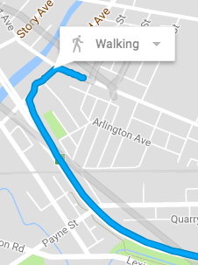
Getting location updates
Your app can get the last known location.
It can also ask for regular updates to track location
Use LocationRequest to set parameters for location update requests

Slide 37
LocationRequest parameters
Set LocationRequest parameters to control location requests
setInterval(): Sets how frequently your app needs updates
setFastestInterval(): Sets limit to the update rate to prevent flicker/data overflow
setPriority(): Sets request priority and sources

Slide 38
Request priority values
PRIORITY_BALANCED_POWER_ACCURACY | Precise to within city block (100 meters); uses only Wi-Fi and cell network, to consume less power
PRIORITY_HIGH_ACCURACY | Uses GPS if available
PRIORITY_LOW_POWER | City-level precision (10 km)
PRIORITY_NO_POWER | Updates when triggered by other apps (zero additional power)

Slide 39
Create LocationRequest example
private LocationRequest getLocationRequest() {
LocationRequest locationRequest = new LocationRequest();
locationRequest.setInterval(10000);
locationRequest.setFastestInterval(5000);
locationRequest.setPriority(
LocationRequest.PRIORITY_HIGH_ACCURACY);
return locationRequest;
}

Slide 40
Requesting location updates

Slide 41
Requesting location updates
Use LocationRequest with FusedLocationProviderClient
Accuracy of location determined by:
Available location providers (network and GPS)
Location permission requested
Options set in location request

Slide 42
Steps to start location updates
Create LocationRequest object
Override LocationCallback.onLocationResult()
Use requestLocationUpdates() on FusedLocationProviderClient to start regular updates

Slide 43
Steps to start location updates
Use requestLocationUpdates() to start regular updates
Pass in LocationRequest and LocationCallback
Location updates are delivered to onLocationResult()

Slide 44
Using LocationCallback
mLocationCallback = new LocationCallback() {
@Override
public void onLocationResult(
LocationResult locationResult) {
for (Location location : locationResult.getLocations()) {
// Update UI with location data
// ...
}
};

Slide 45
Working with user settings

Slide 46
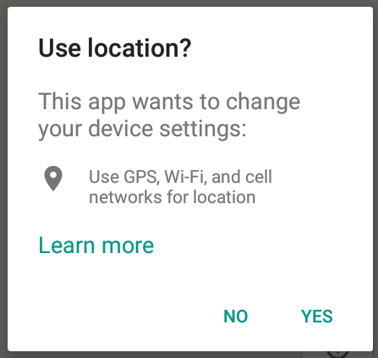
User settings for location services
Users can control balance between accuracy and power consumption
Your app can:
Detect device settings
Prompt user to change them

Slide 47
Steps to check device settings
Create a LocationSettingsRequest object
Create a SettingsClient object
Use checkLocationSettings() to see if device settings match LocationRequest
Use OnFailureListener to catch when settings don't match LocationRequest

Slide 48
Create a LocationSettingsRequest
Create a LocationSettingsRequest object and add one or more location requests:
LocationSettingsRequest settingsRequest =
new LocationSettingsRequest.Builder()
.addLocationRequest(mLocationRequest).build();

Slide 49
2. Create a SettingsClient
Create a SettingsClient object using LocationServices.getSettingsClient() and pass in the context:
SettingsClient client =
LocationServices.getSettingsClient(this);

Slide 50
3. See if device settings match request
Use checkLocationSettings() to see if device settings match LocationRequest:
Task<LocationSettingsResponse> task =
client.checkLocationSettings(settingsRequest);
Returns a Task object

Slide 51
4. Catch when settings don't match
Use OnFailureListener to catch when settings don't match LocationRequest
Exception passed into onFailure() contains Status
If settings don't match, then status is LocationSettingsStatusCodes.RESOLUTION_REQUIRED
Show dialog to change settings

Slide 52
Sample code for user dialog
task.addOnFailureListener(this, new OnFailureListener() {
@Override
public void onFailure(@NonNull Exception e) {
int statusCode = ((ApiException) e).getStatusCode();
if (statusCode ==
LocationSettingsStatusCodes.RESOLUTION_REQUIRED) {
// Show the user a dialog.
// ...
}
}
});

Slide 53
Sample code for user dialog (continued)
// Show the user a dialog.
try {
// Call startResolutionForResult(), check
// result in onActivityResult()
ResolvableApiException resolvable =
(ResolvableApiException) e;
resolvable.startResolutionForResult
(MainActivity.this,REQUEST_CHECK_SETTINGS);
} catch (IntentSender.SendIntentException sendEx) {
// Ignore the error
}

Slide 54
Handle the user's decision
Override onActivityResult() in Activity
Ensure requestCode matches constant in startResolutionForResult()

Slide 55
Sample onActivityResult method
@Override
protected void onActivityResult(int requestCode,
int resultCode, Intent data) {
if (requestCode == REQUEST_CHECK_SETTINGS) {
if (resultCode == RESULT_CANCELED) {
stopTrackingLocation();
} else if (resultCode == RESULT_OK) {
startTrackingLocation();
}
}
super.onActivityResult(requestCode, resultCode, data);
}

Slide 56
What's next?
Concept chapter: 7.1 Location services
Practical: 7.1 Using the device location

Slide 57
END

